Slide 1
LARAVEL PHP SERVER SIDE RESTFUL
API BEST PRACTICES
SERVER SIDE
2016
Name: Vu Quang Son

Slide 2
Table of content
Versioning
Routing
Filter, sort, search, paging
Json format
HTTP Status Code
Other best practices

Slide 3
Versioning
  /api/v1
  /public/api/v1/apps

Slide 4
Versioning (Best Practices)
  API Version is always required
  Use simple number (1, 2, …) & avoid dot such as 2.5
  Versioning starting with the letter “v”

Slide 5
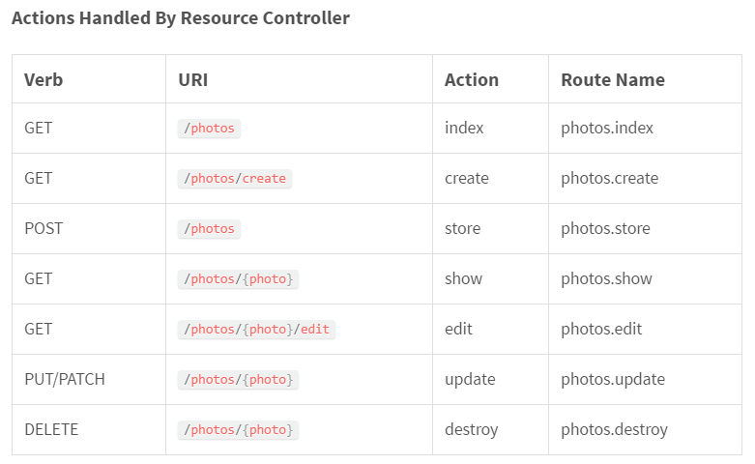
Routing

Slide 6
Routing (cont)
GET /answers - Retrieves a list of answers
GET /answers/12 - Retrieves a specific answer
POST /answers - Creates a new answers
PUT /answers/12 - Updates answer #12
DELETE /answers/12 - Deletes answer #12

Slide 7
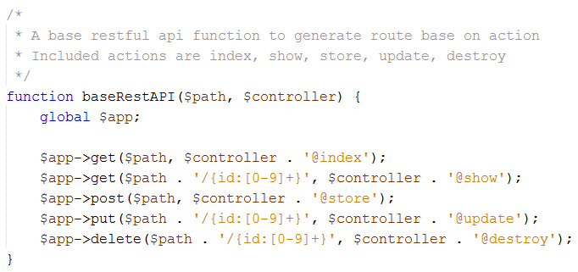
Implement Routing

Slide 8
Routing
(Advantages & Best Practices)
  Apply existing HTTP Methods to implement multiple functions on just single /answers endpoint
  No naming conventions to follow and URL is clean & clear
  Use nouns not verbs
  Use only plural nouns

Slide 9
Routing
(Discussion)
  How about custom routes?
    GET /apps/filter
    GET /apps/related
  How about routes with multiple words
    Use dashes ( - ) for words delimiter
  Deal with multiple objects
    POST /answers/create
    PUT /answers/edit
    DELETE /answers/remove

Slide 10
Routing
(Discussion)
  Deal with relations?
    GET /apps/12/questions
    GET /questions?app_id=12
    GET /apps/12/questions/14/medias
    GET /medias?app_id=12&question_id=14

Slide 11
FILTER, SORT, SEARCH, PAGING
  FILTER
    Use unique query parameter for each field that implements filtering
    Use database fields for faster implementation
    GET /apps?status=draft
    GET /apps?status=published&featured=1

Slide 12
FILTER, SORT, SEARCH, PAGING
  FILTER (Discussion & Improvement)
    The best if can also filter with most used parameters
      &gt, &lt, &gte, &lte, …
    GET /apps?rating[value]=2&rating[operator]="&gte“
    GET /apps?price[value]=0&price[operator]="&gt“
    GET /apps?has_price=1
Notes:
https://www.drupal.org/project/restful_search_api

Slide 13
FILTER, SORT, SEARCH, PAGING
  SORT
    Defined constant sort
    Parameters delimiter by comma (,)
    -created_at for DESC
    create_at for ASC
    GET /apps?sort=-created_at,id

Slide 14
FILTER, SORT, SEARCH, PAGING
  SEARCH
    Defined constant search (search or q?)
    GET /apps?search=“IBM test”
    GET /apps?q=“IBM test”

Slide 15
FILTER, SORT, SEARCH, PAGING
  SEARCH (Discussion & Improvement)
    search or q keyword?
    GET /apps?search=“IBM test”
    GET /apps?q=“IBM test”
    GET /apps?q[value]=“IBM”&q[field]=“title”

Slide 16
FILTER, SORT, SEARCH, PAGING
  PAGING
    Defined constant limit and offset
    Default limit = 10 & offset = 0
    /apps?limit=20&offset=10
    Want no limit?
      /apps?limit=
      /apps?limit=0

Slide 17
FILTER, SORT, SEARCH, PAGING
  PAGING
    Defined constant limit and offset
    Default limit = 10 & offset = 0
    /apps?limit=20&offset=10
    Want no limit?
      /apps?limit=
      /apps?limit=0

Slide 18
FILTER, SORT, SEARCH, PAGING
  Limit fields returned by API
    Defined constant fields
    GET /apps?fields=id,title,created_at

Slide 19
JSON FORMAT (Success)
  {
  "errorCode": null,
  "message": null,
  "result": [ ]
  }
  {
  "errorCode": null,
  "message": null,
  "result": { }
  }

Slide 20
JSON FORMAT (Error)
  {
  "errorCode": "validation_error",
  "message": [
  “The selected icon is invalid.”,
  “The icon is invalid or in used”
  ],
  "result": null
  }

Slide 21
JSON FORMAT (Error)
  {
  "errorCode": "validation_error",
  "message": {
  "icon": [
  "The selected icon is invalid."
  ],
  "background": [
  "The selected background is invalid."
  ]
  },
  "result": null
  }

Slide 22
AVOID BAD PRACTICE
  {
  "errorCode": "validation_error",
  "message": null,
  "result": [
  1: { },
  2: { }
  ]
  }

Slide 23
HTTP STATUS CODE
  200 OK – successful GET, PUT, DELETE
  201 Created – successful POST in creation
  204 No Content – successful request like DELETE
  304 Not Modified – for caching
  400 Bad Request – malformed request, cannot parse
  401 Unauthorized – invalid authentication
  403 Forbidden – do not have access
  404 Not Found – resource doesn’t exist
  405 Method Not Allowed – not implemented/not allow
  412 Precondition Failed – validation header
  422 Unprocessable Entity – validation body
  429 Too Many Requests – reject due to rate limit
  500 Internal Server Error – server error
Notes:
https://github.com/FriendsOfCake/crud/issues/337

Slide 24
HTTP STATUS CODE
(Discussion & Improvement)
  Using 201 Created – for successful POST in creation instead of 200 OK
  Using 422 Unprocessable Entity – for validation error instead of 412 Precondition Failed
Notes:
https://github.com/FriendsOfCake/crud/issues/337

Slide 25
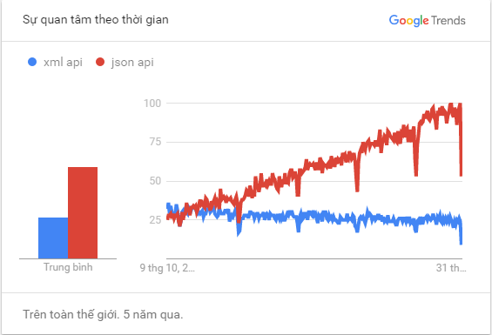
OTHER BEST PRACTICES
  Using json only for response

Slide 26
OTHER BEST PRACTICES
  Always enable Gzip for api
  Handle Cors (Coss-Origin Resource Sharing)
  Allow overriding HTTP method (X-HTTP-Method-Override)

Slide 27
REFERENCE
  http://www.vinaysahni.com/best-practices-for-a-pragmatic-restful-api
  https://laravel.com/docs/5.3/controllers
  http://blog.mwaysolutions.com/2014/06/05/10-best-practices-for-better-restful-api/
  https://github.com/FriendsOfCake/crud/issues/337
  https://saipraveenblog.wordpress.com/2014/09/29/rest-api-best-practices/

Slide 28
Q & A

Slide 29


